Slide 1
Predictive Modelling of University Dropouts
Team 2 – The Cabbages
Project 4 Data Visualisation Bootcamp
Yasar, Tooba, Musab, Ifa & Zeeshan

Slide 2
Tooba to add background
Are there any models outthere predicting drop out
Dropout rates in Denmark are 80%
Italy 46%
Etc
etc

Slide 3
Data Source
Kaggle
Csv file
The data has been compiled from data held by the Portugese equivalent of UCAS:
National Competition for Access to Higher Education

Slide 4
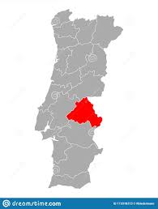

Dataset
Portuguese data from the Polytechincal Institute of Portalegre.
Data from 2008/9- 2018/19 academic years
17 different undergraduate degrees eg agronomy, design, education, nursing, journalism, management, social service, and technologies
4424 records
35 attributes (columns)

Slide 5
Dataset description
Attributes can be grouped as follows:
Demographic Data on Student
Socioeconomic Data of Student
Macroeconomic Data of Students Home Region?
Academic Data at enrollement and then after 1st and 2nd semester

Slide 6
Data Analysis
We performed a brief exploratory data analysis using
Python 3 using the Pandas library version
1.4.3, the Scikit-learn library version
1.1.1, and
Tableua versionXXX
for visualizations

Slide 7
Data Cleaning and Processing
We removed the enrolled rows (approximately 700 rows)
We removed the application mode and order. This information was administrative and could potentially confuse our modelling analysis.
We imported the data into SQL and used SQL lite viewer.

Slide 8
Data Processing
We changed the categorical target data labels of graduate vs dropout into binary 0 vs 1 in order to for our model to work.

Slide 9
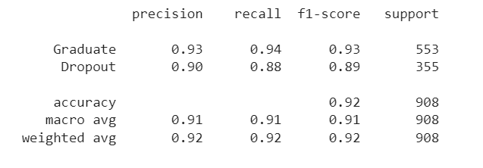
Supervised Learning Model
We used a logistical regression model to determine the target variable of “dropout vs graduate”, using the 32 attributes (columns/features) that were provided in the database.
We used a training/testing split of 75%/25%
We were able to achieve
An overall accuracy score of
92%

Slide 10
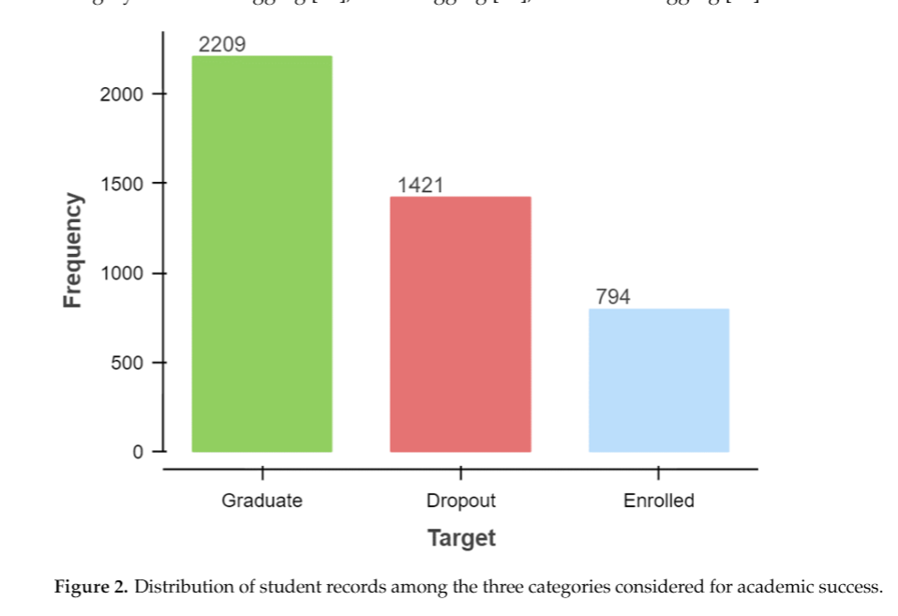
However our original data was skewed towards those who graduate
This is not our graph it is someone elses, we need to make our own.

Slide 11
Therefore we used RandomOverSampler Module from the Imbalanced Library to Retrain the Model.
When using the oversampled data of the dropouts
- the overall accuracy remained the same at 92%,
- however the recall for the dropout label increased from 86% to 88%

Slide 12
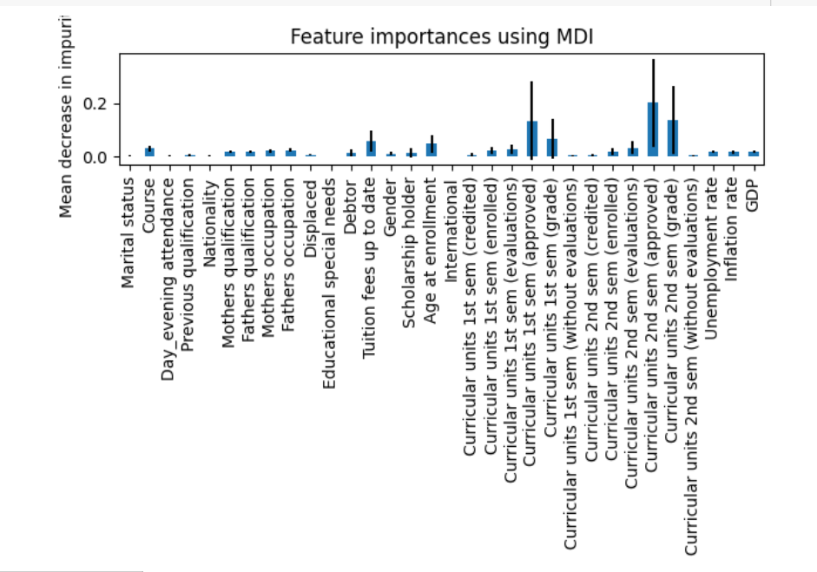
We then used RandomForest to determine the features of Importance and here is our baseline

Slide 13
We then removed the features with the least importance and retrained the model………………….

Slide 14
We retrained the model using a test/train split of 80/20 and the RandomOverSample module.
This showed an accuracy of ……………..

Slide 15
We assessed each feature with colinearity against a second feature
Pearson coefficient

Slide 16
Anonymity
All data are anonymized, and compliance with the Privacy and Personal Data Process-
ing Policy of the institution is ensured according to the General Data Protection Regulation
(GDPR). This dataset is also compliant with the FAIR (Findability, Accessibility, Interoper-
ability, and Reusability) principles for scientific data management

